Slide 1
A Greedy Heuristic Deployment strategy for VNFs

Slide 2
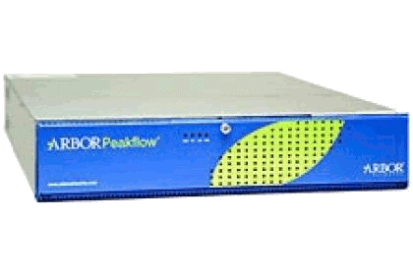
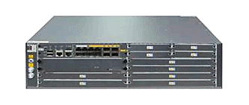
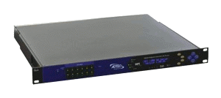
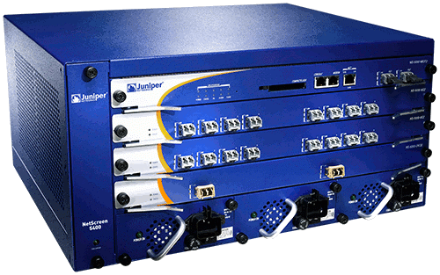
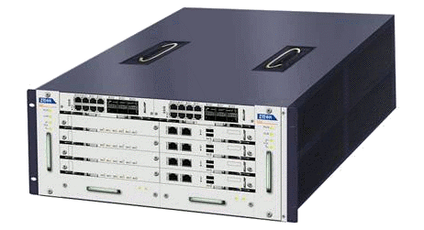
Background
Expensive equipment/power costs
Difficult to add new features!
Difficult to manage
Middlebox which is playing a crucial role in current network can provide plentiful network functions.
Cannot be scaled on demand
Hardware middleboxes drawbacks.
By separating network function from the underlying hardware, the deployment will be more flexible.
How to deploy dynamic, flexible and robust service function is an attractive and useful problem.
ad insertion
DDoS protection
IDS
firewall
BRAS

Slide 3
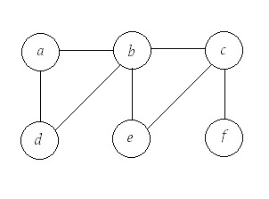
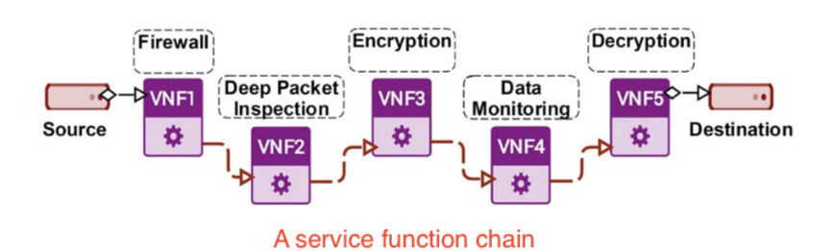
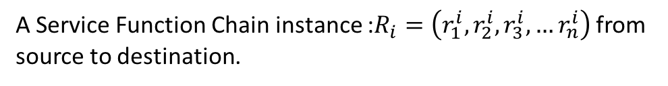
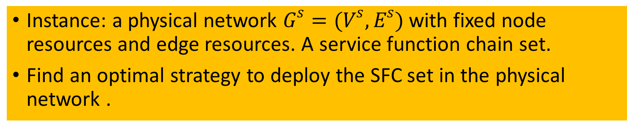
Resource Scheduling for Network Function Virtualization
Instance: a physical network $G^{s}=(V^{s},E^{s})$ with fixed node resources and edge resources. A service function chain set.
Find an optimal strategy to deploy the SFC set in the physical network .
A physical network instance:
A Service Function Chain instance :$R_{i}=\left(r_{1}^{i},r_{2}^{i},r_{3}^{i},…r_{n}^{i}\right)$ from source to destination.

Slide 4
Related work
Resources Allocation of SFC
Virtual Machine Deployment
Virtual Network Embedding

Slide 5
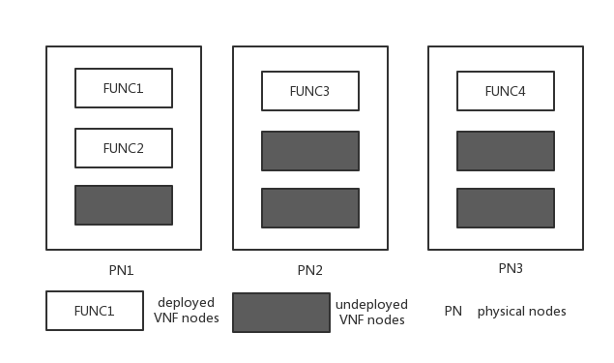
Resources Allocation of SFC
Input: a physical network and a SFC set.
Output: a network function deployment .
Differences:
A physical node can be deployed with many functions.
No share function node.
Fixed requirements.

Slide 6
Virtual Machine Deployment
Requirements are deployed in the virtual machine, and virtual machine is deployed in the physical node.
The problem of virtual machine deployment is to find a suitable place for virtual machine.
This problem is the next step of the talking problem.

Slide 7
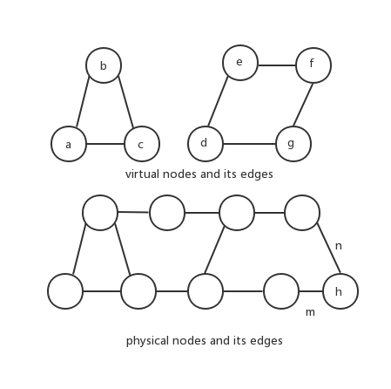
Virtual Network Embedding
Embedded a virtual network to a physical network
It also take allocation of node resources and edge resources into account.
Differences: it is an undirected cyclic graph.

Slide 8
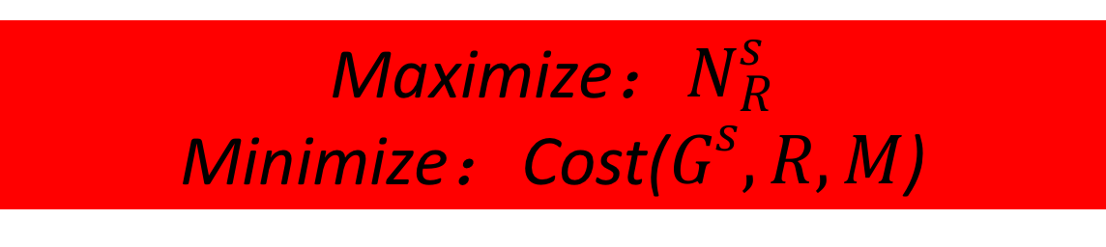
For multi-service chains, to find a optimal deployment plan is a NP-hard problem. Consider the service chain is queued to be deployed.
When the service chain requires, first judge whether the resources is enough.
Under common circumstances, a virtual machine can be deployed with a VNF function, and different service chains can share the same VNF function.
Maximize：$N_{R}^{s}$
Minimize：Cost($G^{s},R,M$)

Slide 9

Deployment mechanisms
Deployment of functions
optimal nodes set will be selected to load all the required VNF because virtual functions of different nodes in the physical network are different.
Selection of path
after selection of nodes, a proper path between nodes is also needed to make one node corresponding with another and achieve a splendid working efficiency.
For an incoming VNF chain requests, we need to map all the VNFs of the service chain and construct a physical path to link all the nodes.

Slide 10
For an incoming VNF chain request, there are 2 choices.
Select a new node where no VNF is deployed.
Select a rest-computing-power-enough node where a same VNF has already been deployed.
if the first choice is used, the whole physical nodes number is high which will increase the cost of node resources of the whole network.
If the second choice is used, the cost of the edge will increase.
How to balance reused nodes and bandwidth costs is a considerable problem!

Slide 11
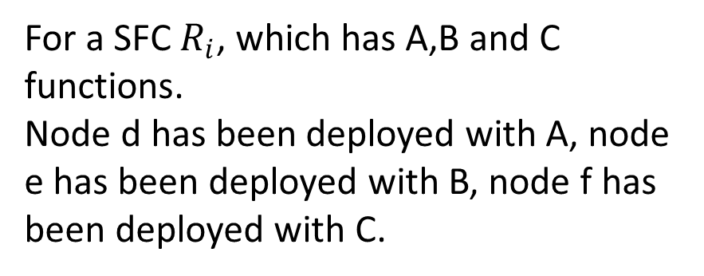
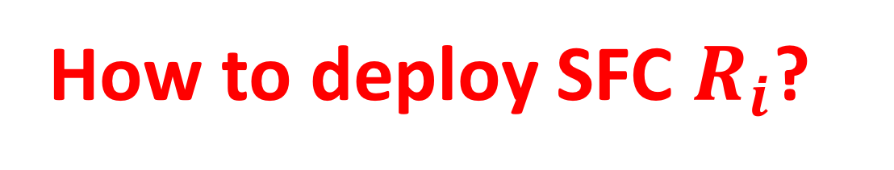
Example
For a SFC $R_{i}$, which has A,B and C functions.
Node d has been deployed with A, node e has been deployed with B, node f has been deployed with C.
How to deploy SFC $R_{i}$?

Slide 12


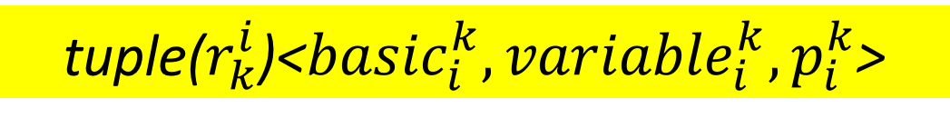
Dynamic requirements
The computing resources which is required by a virtual network function is not definite.
tuple($r_{k}^{i}$)<${basic}_{i}^{k},{variable}_{i}^{k},p_{i}^{k}$>
The required resources consist:
1.Basic requirement ;
2.Floating requirements; in a possibility of p.
How to judge the share
RestCp($v_{i}$) $≥\sum_{i}^{j}{{basic}_{i}^{k}+{variable}_{i}^{k}}$
$$p_{v_{i}}^{R_{i}}∗p_{v_{i}}^{R_{j}}<p^{th}$$

Slide 13
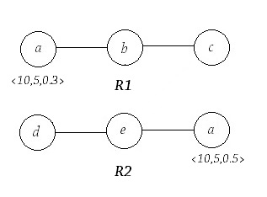
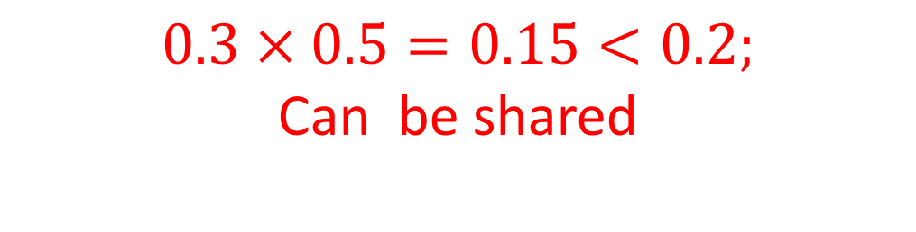
Example
the fixing requirement of
node a in R1 is 10 and the floating requirement of node a is 5 and the possibility is 0.3.
the fixing requirement of
node a in R2 is 10 and the floating requirement of node a is 5 and the possibility is 0.5.
If they want to deploy in a node with 25 computing resources.
$$0.3×0.5=0.15<0.2;$$
Can be shared

Slide 14
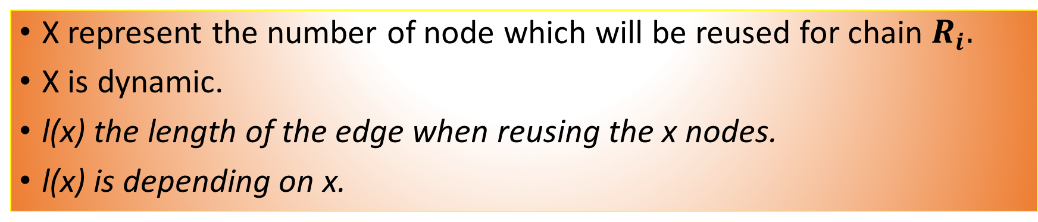
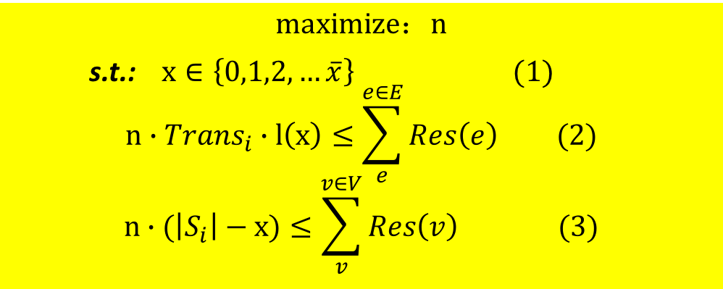
How to reuse physical nodes?
X represent the number of node which will be reused for chain $R_{i}.$
X is dynamic.
l(x) the length of the edge when reusing the x nodes.
l(x) is depending on x.
$$maximize：n$$
s.t.: $x∈\left\{0,1,2,…\overline{x}\right\} (1)$ $$n∙{Trans}_{i}∙l\left(x\right)≤\sum_{e}^{e∈E}{Res\left(e\right)} (2)$$
$$n∙(\left|S_{i}\right|−x)≤\sum_{v}^{v∈V}{Res\left(v\right) (3)}$$
Find reused factor x
Notes:
为什么对于无限多服务链可以成立，是因为这是相比较服务链来说，虚拟机上的节点和资源是巨大的，因此重用因子主要取决于服务链，而不取决于虚拟机。
同时这里节点的可用和资源的可用是一个向量的比较，而非标量的比较。

Slide 15

Sub-chain
Function c can be reused in node A or B.
Function e can be reused in node C or D.
Else can not be reused.
a-b-c
c-d-e
e-f

Slide 16
A heuristic deployment plan
1. Find the reused function x for an incoming VNF chain. 2. Divide a service chain into (x+1) sub-chains. 3. Greedily find an optimal deployment for each sub-chain, and finally deploy the entire VNF service chain.

Slide 17
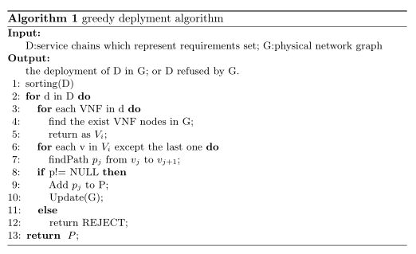
Greedy Algorithm

Slide 18
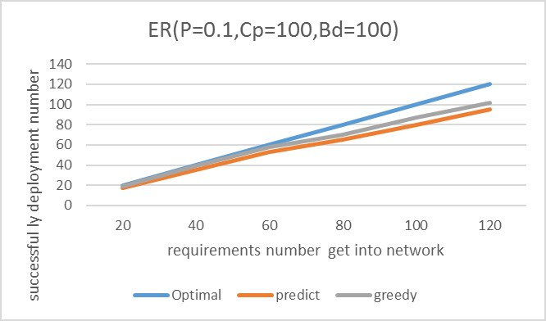
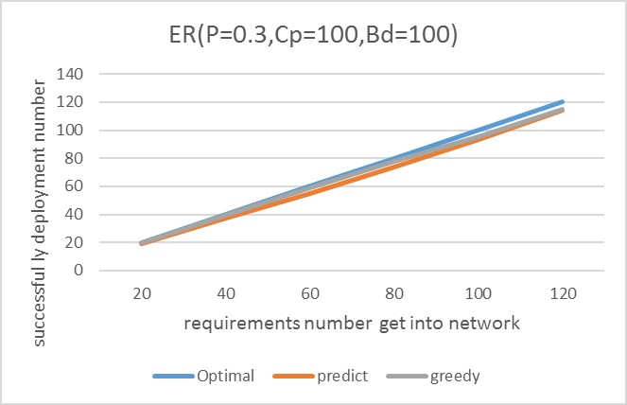
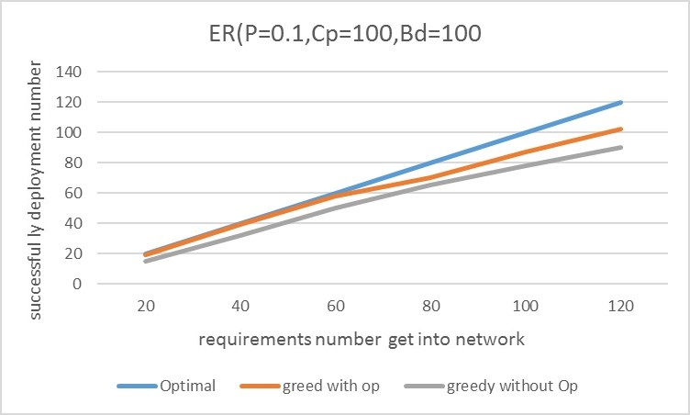
Simulation justification

Slide 19
Conclusion
Resource Scheduling for Network Function Virtualization
Dynamic requirements
Reused nodes
Greedy algorithm
ensure the stability of the network and also increase the efficiency

Slide 20
Thank you!

